Slide 1
Issues of scale in next-gen archives
Jefferson Heard
RENCI, UNC Chapel Hill
jeff@renci.org
Richard Marciano, SILS, UNC Chapel Hill
marciano@unc.edu

Slide 2
Why do current methods fall short?
Current archive methods follow traditional methods.
Digital analogues of box, file, series, etc.
In digital archives, trends could put a millions of boxes in a single archive in just a few years.
Notes:
Traditional archiving methods box up files and develop finding aids that help you locate a record based on knowing more or less what you’re looking for. The problem with this method in the next generation of archives is that “more or less” won’t cut it. Using current methods, you will need to know exactly what you’re looking for to be able to narrow down your search enough to avoid trawling through mountains of documents and data. If narrowing down a source in a state library’s archive today takes a matter of a few days using current methodology, it will take weeks or months in the archives to come.

Slide 3
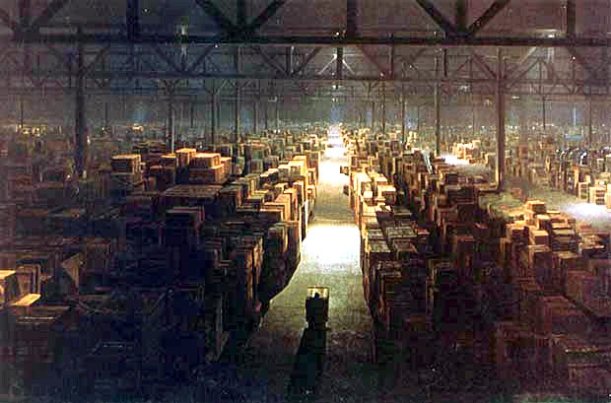
Imagine a FOIA request on this
Notes:
How much would a FOIA request COST if you had to do a significant search on this? If you had enough to pay the cost, could you actually find enough qualified researchers to help you locate what you’re after? Who bears that cost and how does monetary, manpower, and expertise costs serve as a barrier to servicing legitimate and reasonable requests? Importantly, legal offices, especially those in the public interest are often served with so-called “adversarial” discovery, where a group, submitting to a discovery request, hands the party making the request an unordered mountain of documents and says “Go to town. It’s somewhere in there.”

Slide 4

The bottom line
Skeumorphism – n. The use of archaic or
vestigial elements in a design to retain user
familiarity.
Skeumorphims in digital archives
will not work.
Notes:
We could talk about archives in terms of “series” and “boxes” and so on, but why? The term “document” or “file” barely holds water with new archives, which often contain multiple physical files for a single record, and in fact as we’ll see in a minute, a record or notion of a file is far richer in a digital archive than in a paper one. In my mind, we talk about these new archives in terms of the tasks we require of them. Preservation, discovery, browsing, search. These core tasks will define the future of the terminology and inform the way we structure the archiving process.

Slide 5
Richer, more complex?
How can we possibly be more complex than the warehouse in Indiana Jones?
Link from digital object to a physical object
Digital object
Digital archive system
Physical object
Link from physical object to digital object
Digital object
Digital archive system
Physical object
Notes:
The indiana jones warehouse is boxes upon boxes, seemingly without in, in rows and rows of jumbles. How can you claim more complexity than that? In mathematics, we have the notion of the countably and uncountably infinite. That is, you can count from 1 to infinity, but how many real numbers are between 0 and 1? Another infinity of distinct numbers between every regular countable number. The second you add links from the physical world into the digital world you take a similar great leap in complexity. Making systems like this manageable is one of the grand challenges, I think, of preservation.

Slide 6
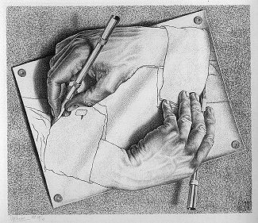
Richer, more complex?
Non textual data are handled in the physical world by someone actually describing them.
Notes:
Closer to home, though, there are simply more classes of digital objects likely to be archived than physical ones, and they age differently and sometimes more extremely than physical objects. In keeping up with software versions, file formats, etcetera, a file can go from readable to unreadable in a flash of an eye, and software vendors are under no obligation to keep older versions of data readable. You could no more archive a bathtub full of soap bubbles than preserve some digital data.

Slide 7
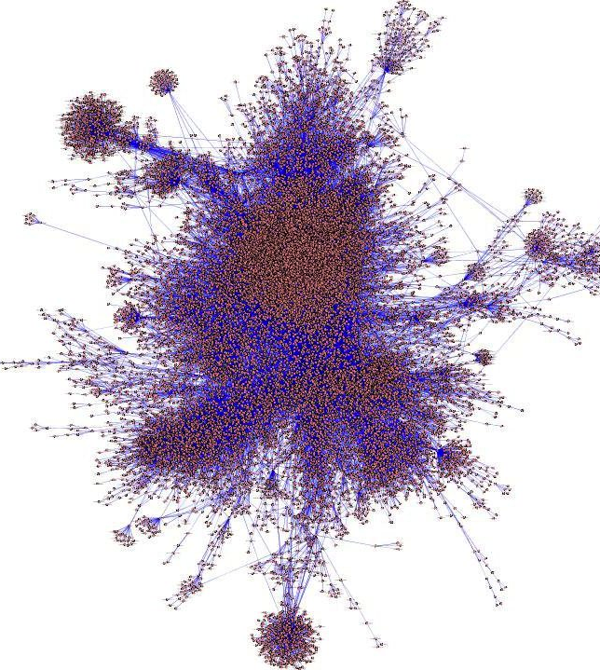
Richer, more complex?
This is impossible considering the number of digital non-textual objects.
http://www.mkbergman.com/419/so-what-might-the-webs-subject-backbone-look-like/
Notes:
Closer to home, though, there are simply more classes of digital objects likely to be archived than physical ones, and they age differently and sometimes more extremely than physical objects. In keeping up with software versions, file formats, etcetera, a file can go from readable to unreadable in a flash of an eye, and software vendors are under no obligation to keep older versions of data readable. You could no more archive a bathtub full of soap bubbles than preserve some digital data.

Slide 8
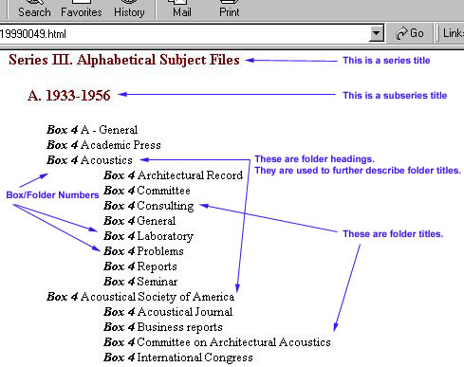
Richer, more complex?
The number of classes of digital objects (likely to be archived) is greater than the number of classes of physical objects (likely to be archived).
Notes:
Closer to home, though, there are simply more classes of digital objects likely to be archived than physical ones, and they age differently and sometimes more extremely than physical objects. In keeping up with software versions, file formats, etcetera, a file can go from readable to unreadable in a flash of an eye, and software vendors are under no obligation to keep older versions of data readable. You could no more archive a bathtub full of soap bubbles than preserve some digital data.

Slide 9
The CI-BER project
CyberInfrastructure for Billions of Electronic Records
  Funded by NARA / NSF since 2010
  See: http://ci-ber.blogspot.com/
  See:http://www.whitehouse.gov/sites/default/files/microsites/ostp/big_data_fact_sheet_final.pdf
    Included in the White House fact sheet titled, “Big Data Across the Federal Government,” which was distributed in conjunction with the announcement.
Scale systems to billions of electronic records.
  Browsing.
  Indexing.
  Triage, vetting, search.
Notes:
So largely, these problems are intractable today, but fortunately the worst of the data tsunami is a few years out. We have some lead time. So we began the CI-BER project to consider some of these issues, and begin sketching out solutions, messy and imperfect as they are.

Slide 10
The test collection
75 million records
70 TB of data
150 government agencies
Files in every format, of every quality.
Radically heterogeneous, ad-hoc structures for managing data
Built on top of the iRODS data grid software:
  Manage a collection that is distributed across multiple heterogeneous resources in multiple administrative domains
  Enforce and validate management policies (retention, disposition, access, quotas, integrity, authenticity, chain of custody, etc.)
  Automate administrative functions (migration, replication, audit trails, reports, caching, aggregation, …)
Applications include shared collections, digital libraries, archives, and processing pipelines.

Slide 12
A geographic subset
1.2 million records
Vector data: made up of points, lines, and polygons
  Political boundaries. Physical features. Demographics.
Raster data: made up of discrete points defined continuously over a field
  Imagery. Environmental modeling. Land use.
100s of data formats.
10,000s of projections. (mapping of globe to flat surface)

Slide 13
A “typical” geographic dataset
Timeseries continuously growing every 6 hours for past 3 years and next 3 at least.
625,000 items per timestamp.
25 elements per item.
15 source files go into the production of this, all of which must be archived as well as the workflow used to generate the final dataset.
How to retrieve, browse, view, understand this data?
Notes:
This wall of statistics gives you an idea of what one “record” in a geographic context might be. These stats are those of the world’s most advanced hurricane surge model, in use now by emergency managers dealing with the effects of Sandy. But to understand Sandy, we have to go back to historical storms to see what the effects of similar events were. To do that, we need archives, but importantly we also need browsing mechanisms that show us the data in context and link it with other archived data that may be easier to relate to than days after days and hours after hours of visuals. Like, oh, a timeline.
Show the big board after this slide.

Slide 14
General ideas for indexing large collections
Archival metadata in large digital collections is often sparse and must be automatically extracted.
Really large collections, it may not be useful to extract metadata from every file.
For radically heterogeneous collections there is no one-size-fits-all solution to index.
Notes:
How do you make an index that can accommodate all this? You need something that supports prototyping, because you will not know what the metadata is going in, and you’ll need to experiment before you have an interface worth using. With really heterogenous collections, you will find that no tool will give you everything, but you need something to start with, and an extensible index is a great whiteboard.

Slide 15
Indexing geographic data
Open tools.
RENCI Geoanalytics.
Custom structures.
Processing heavy, so use many processors.
Notes:
So this is how we did what we’ve done so far. We’re using tools under the umbrella of the OSGEO foundation, out of NC State. We have collected these into a framework we at RENCI are calling Geoanalytics. We’re using heavily custom structures because this is highly customized data. And because this is large, we’re using gangs of computers rather than trying to do this directly in the data store or on a small machine. The index can grow as our collection grows without need to re-index the data.

Slide 16
CI-BER indexing

Slide 17
Cyberinfrastructure: Geoanalytics
Cyberinfrastructure for dealing with huge geographical datasets.
Combines structured and semi-structured representations of geographic data with iRODS, automatic task queues, and open standard sharing protocols.

Slide 18
CI-BER visualizations
Focus on top-down and bottom up browsing of collection geospatial data.
Top down case: start with the directory structure, view how it lays out geospatially.
Bottom-up case: start with the geography and allow the user to browse the collection.

Slide 19
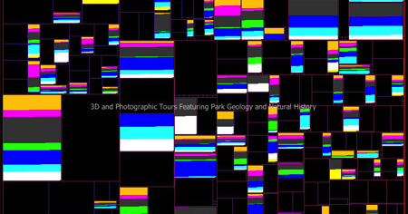
Treemaps
Variables are size, position
and color.
Shows relative composition
of one component to a sub-
collection.
Generally interactive. Users
drill down by clicking on a
square.

Slide 20
Importance of geography
Geography gives explicit social relevance to data. If I see data points clustered over Durham, I immediately see the relevance of that to me.
Also, geography provides structure to otherwise difficult to structure data. Relating data to the physical world, when relevant, can increase a person’s ability to process it.

Slide 21
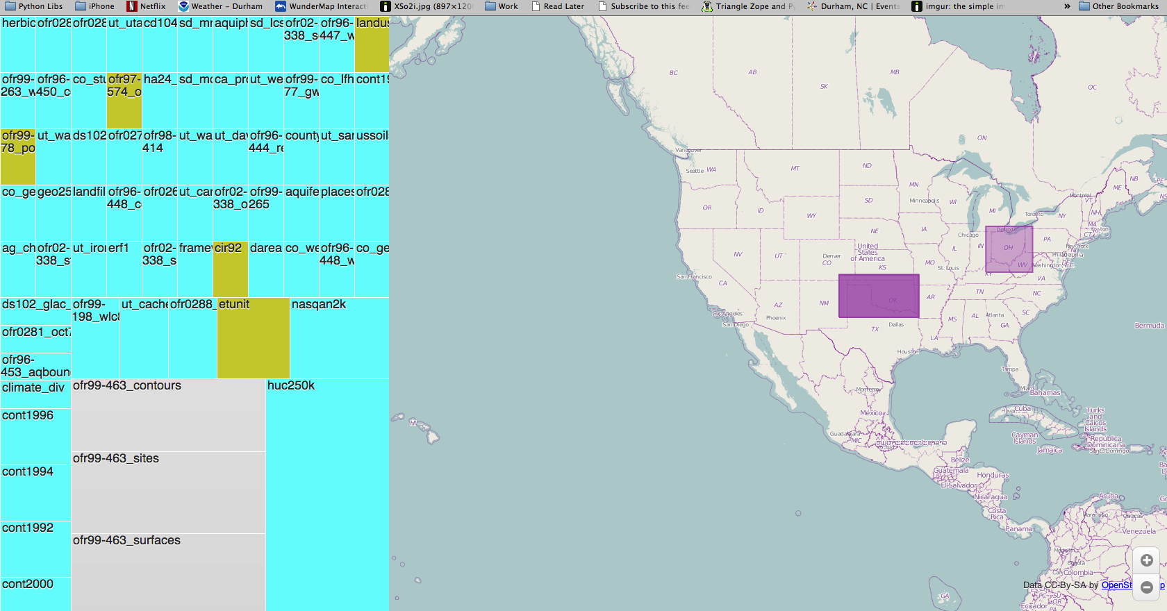
Browsing the index

Slide 22
What indexing geography says about other kinds of data
Geographic data is a microcosm of the heterogeneous data problem.
Automatic tools that go deeper than “file type, owner, etc.” are useful but only apply to their own domain.
Find ways to incorporate ready-made tools rather than rolling your own.
Notes:
Geography is a good place to start with CI-BER because within the small subset of records there is great variability. It has shown us a way forward by using domain specific tools and gluing them together with our extensible index, and that gives us a way forward toward future work.

Slide 23
Future: “dynamic” indexes
How to augment an index? Make it extensible.
New NoSQL solutions like Hadoop, Redis, and MongoDB allow you to append data and add indexes that efficiently search the appended data

Slide 24
Future: intelligent agents
Open an API to the index.
Allow interested researchers to write agents to crawl the index.
Agents download original data and post new metadata to the index, thus augmenting it.

Slide 25
Future: crowdsourcing content
Open APIs and good browsing interfaces open up the opportunity for “interactive archiving”
  Allow users to mark content of interest and annotate it.
  Notify archivists or researchers of this “meta-content” for vetting and incorporating into finding aids.
  Use machine learning to match the interests of people who use an archive similarly.

